Slide 1
A neural network model for fashion-mnıst ımage classıfıcatıon
Name: Omer Faruk coskun
Student ıd: P2756006
Course: ımat5235 – artificial neural networks
Date: 05/11/2025

Slide 2
Introductıon
Problem:
Each 28x28 greyscale image (Fashion-MNIST set) must be correctly assigned to one of 10 different clothing categories.
This involves critically comparing the performance of two different neural network architectures.
Approach:
Implemented two different models:
A baseline ANN (Artificial Neural Network).
A more complex CNN (Convolutional Neural Network).
Used PyTorch to build the system within the Google Colab.

Slide 3
Objective/goals
Load & Pre-process: Loading the dataset, normalizing the pixel values, and split data into Training, Validation, and Test sets.
Implement: ANN and CNN both models built by using scratch nn.Module.
Train & Evaluate: Test Accuracy and Confusion Matrices used to train both models and measure the performance.
Analyse: Focusing onto the confusion between the similar classes and critically compare the the results. (e.g., Coat vs. Shirt).
Improvements: Suggesting improvements (dropout, augmentation).

Slide 4
Methodology
The Data Pipeline
Load: torchvision.datasets.FashionMNIST.
Transform:
ToTensor(): It converts images to the tensors.
Normalize((0.5,), (0.5,)): Scales pixels to [-1,1] range for more stable training.
Split (Validation):
Total of 60.000 training images were split (%90,%10) into:
Training image (54.000) and Validation images (6.000 – used to monitor overfitting).
10.000 test images.
Batch: DataLoader was used for all sets and used 64 Batch Size.

Slide 5
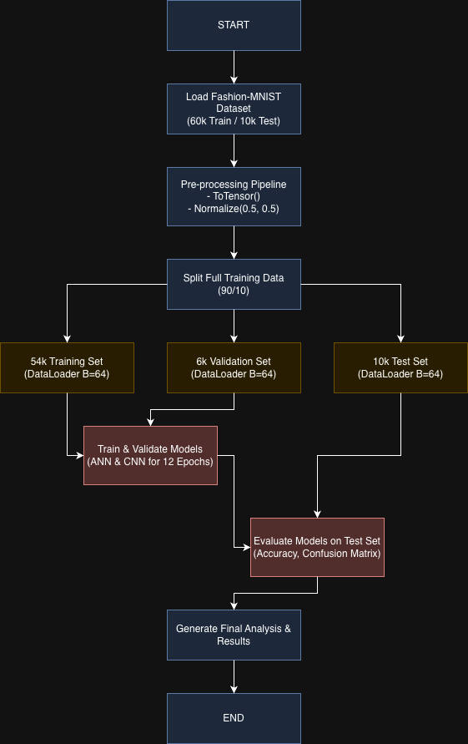

A training model Diagram

Slide 6
Data/materials/Input
Type: 28x28 pixels grayscale images.
Size: 10.000 test and 60.000 training images.
Classes (10):
Sandal, Shirt, Sneaker, Bag, Ankle boot
T-shirt/top, Trouser, Pullover, Dress, Coat
Challenge: There is high visual similarity between certain classes. (e.g. Coat and Shirt).
Normalization: (0.5, 0.5).

Slide 7
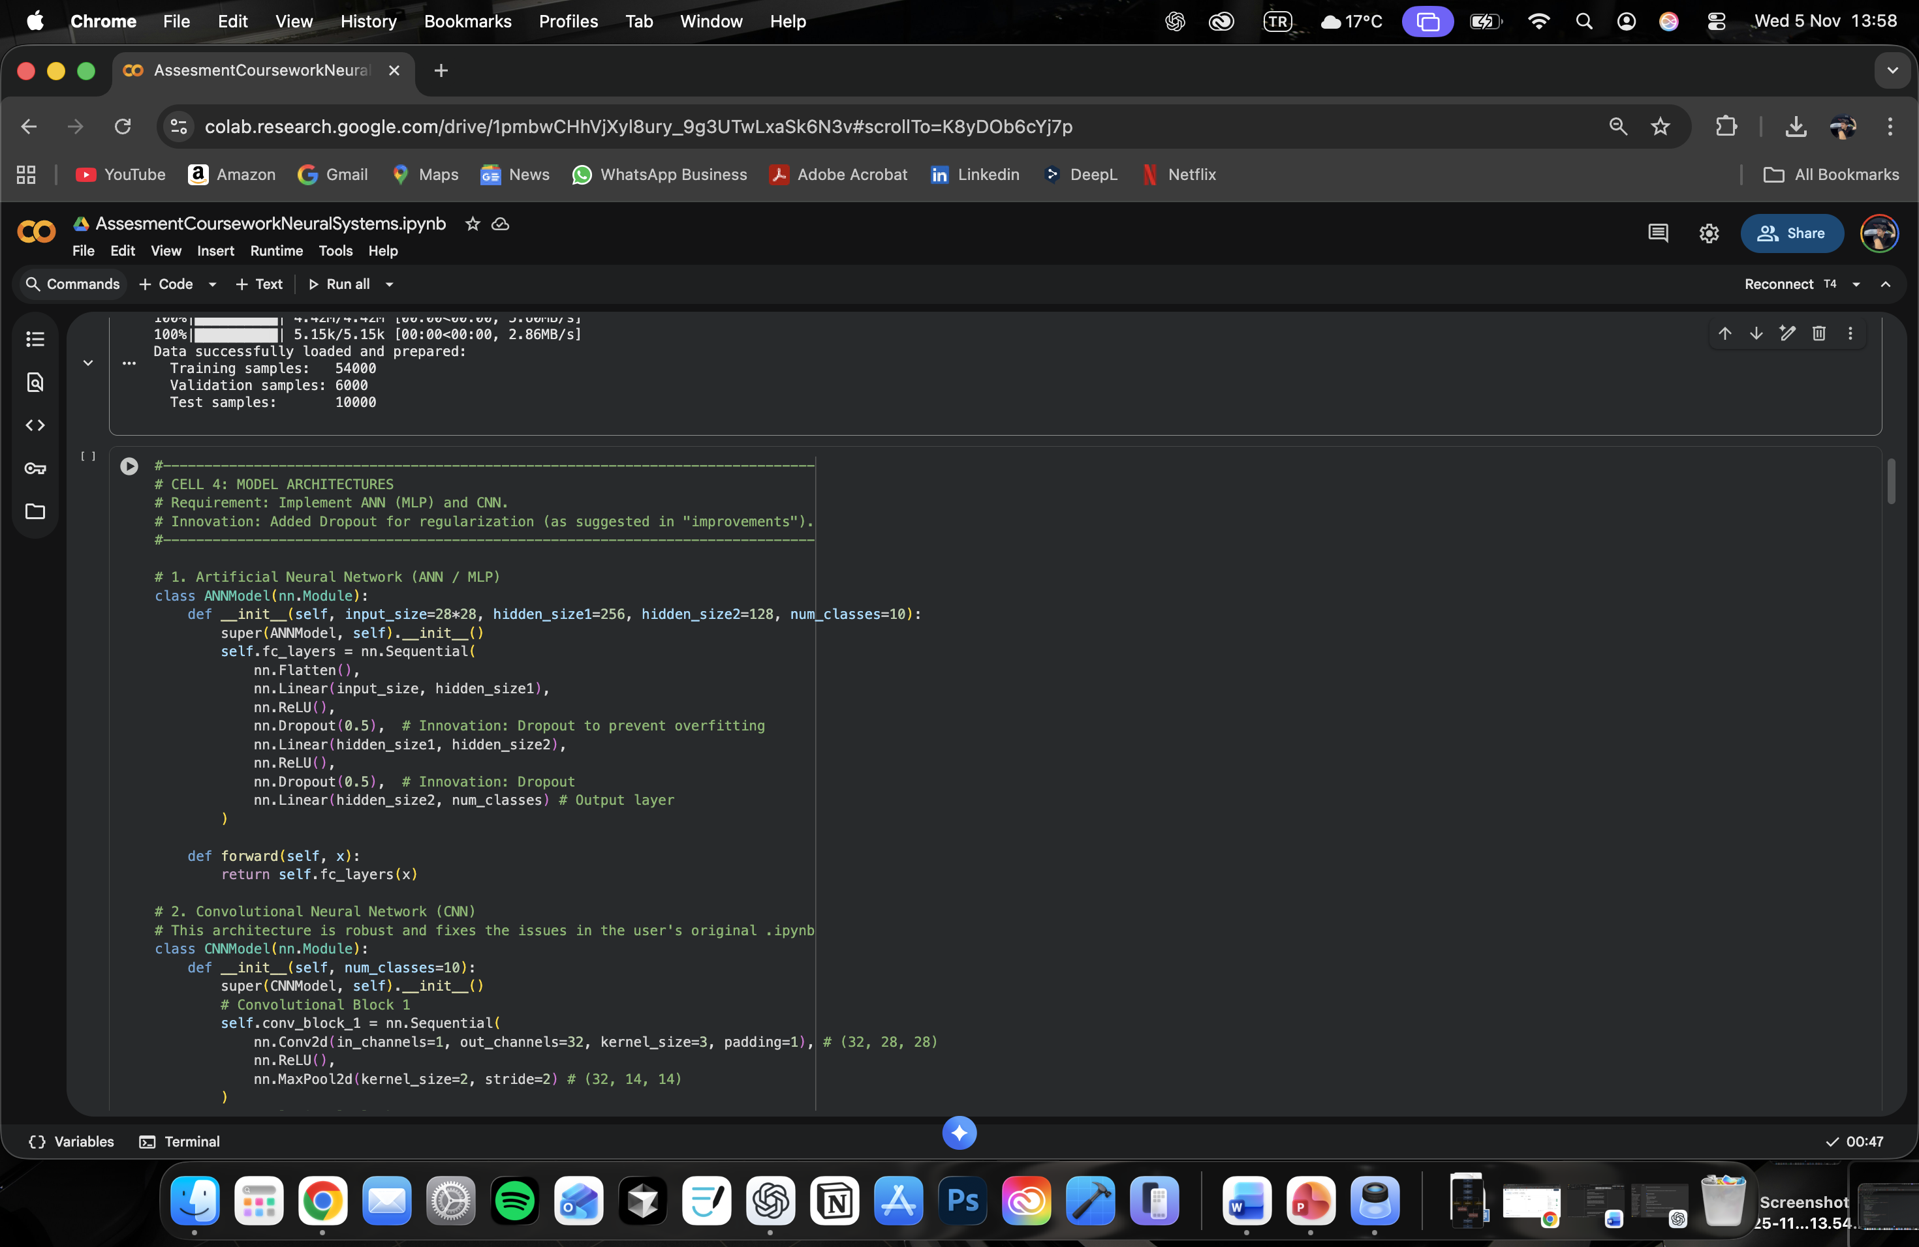
Implementation/process
ANN:
Flatten layer (784 units)
Linear (256 units + ReLU)
Dropout (p=0.5)
Linear (128 units + ReLU)
Dropout (p=0.5)
Linear (10 units)

Slide 8
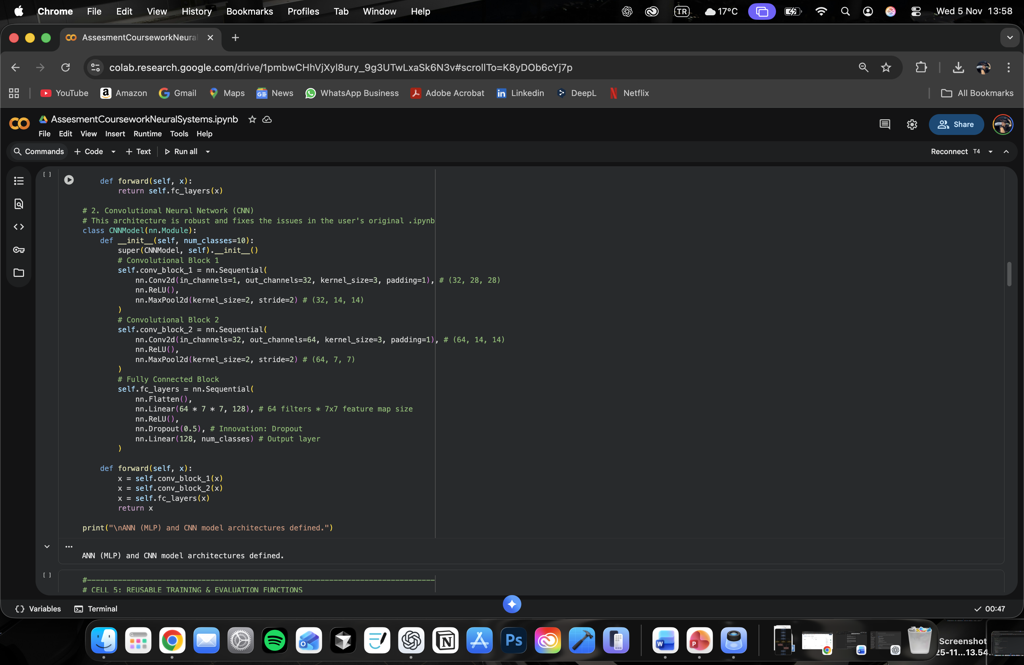
Implementation/process
CNN:
Conv2d (32 filters) + MaxPool2d + ReLU
Conv2d (64 filters) + MaxPool2d + ReLU
Flatten Layer
Linear (128 units) + ReLU
Dropout (p=0.5)
Linear (10 units)

Slide 9
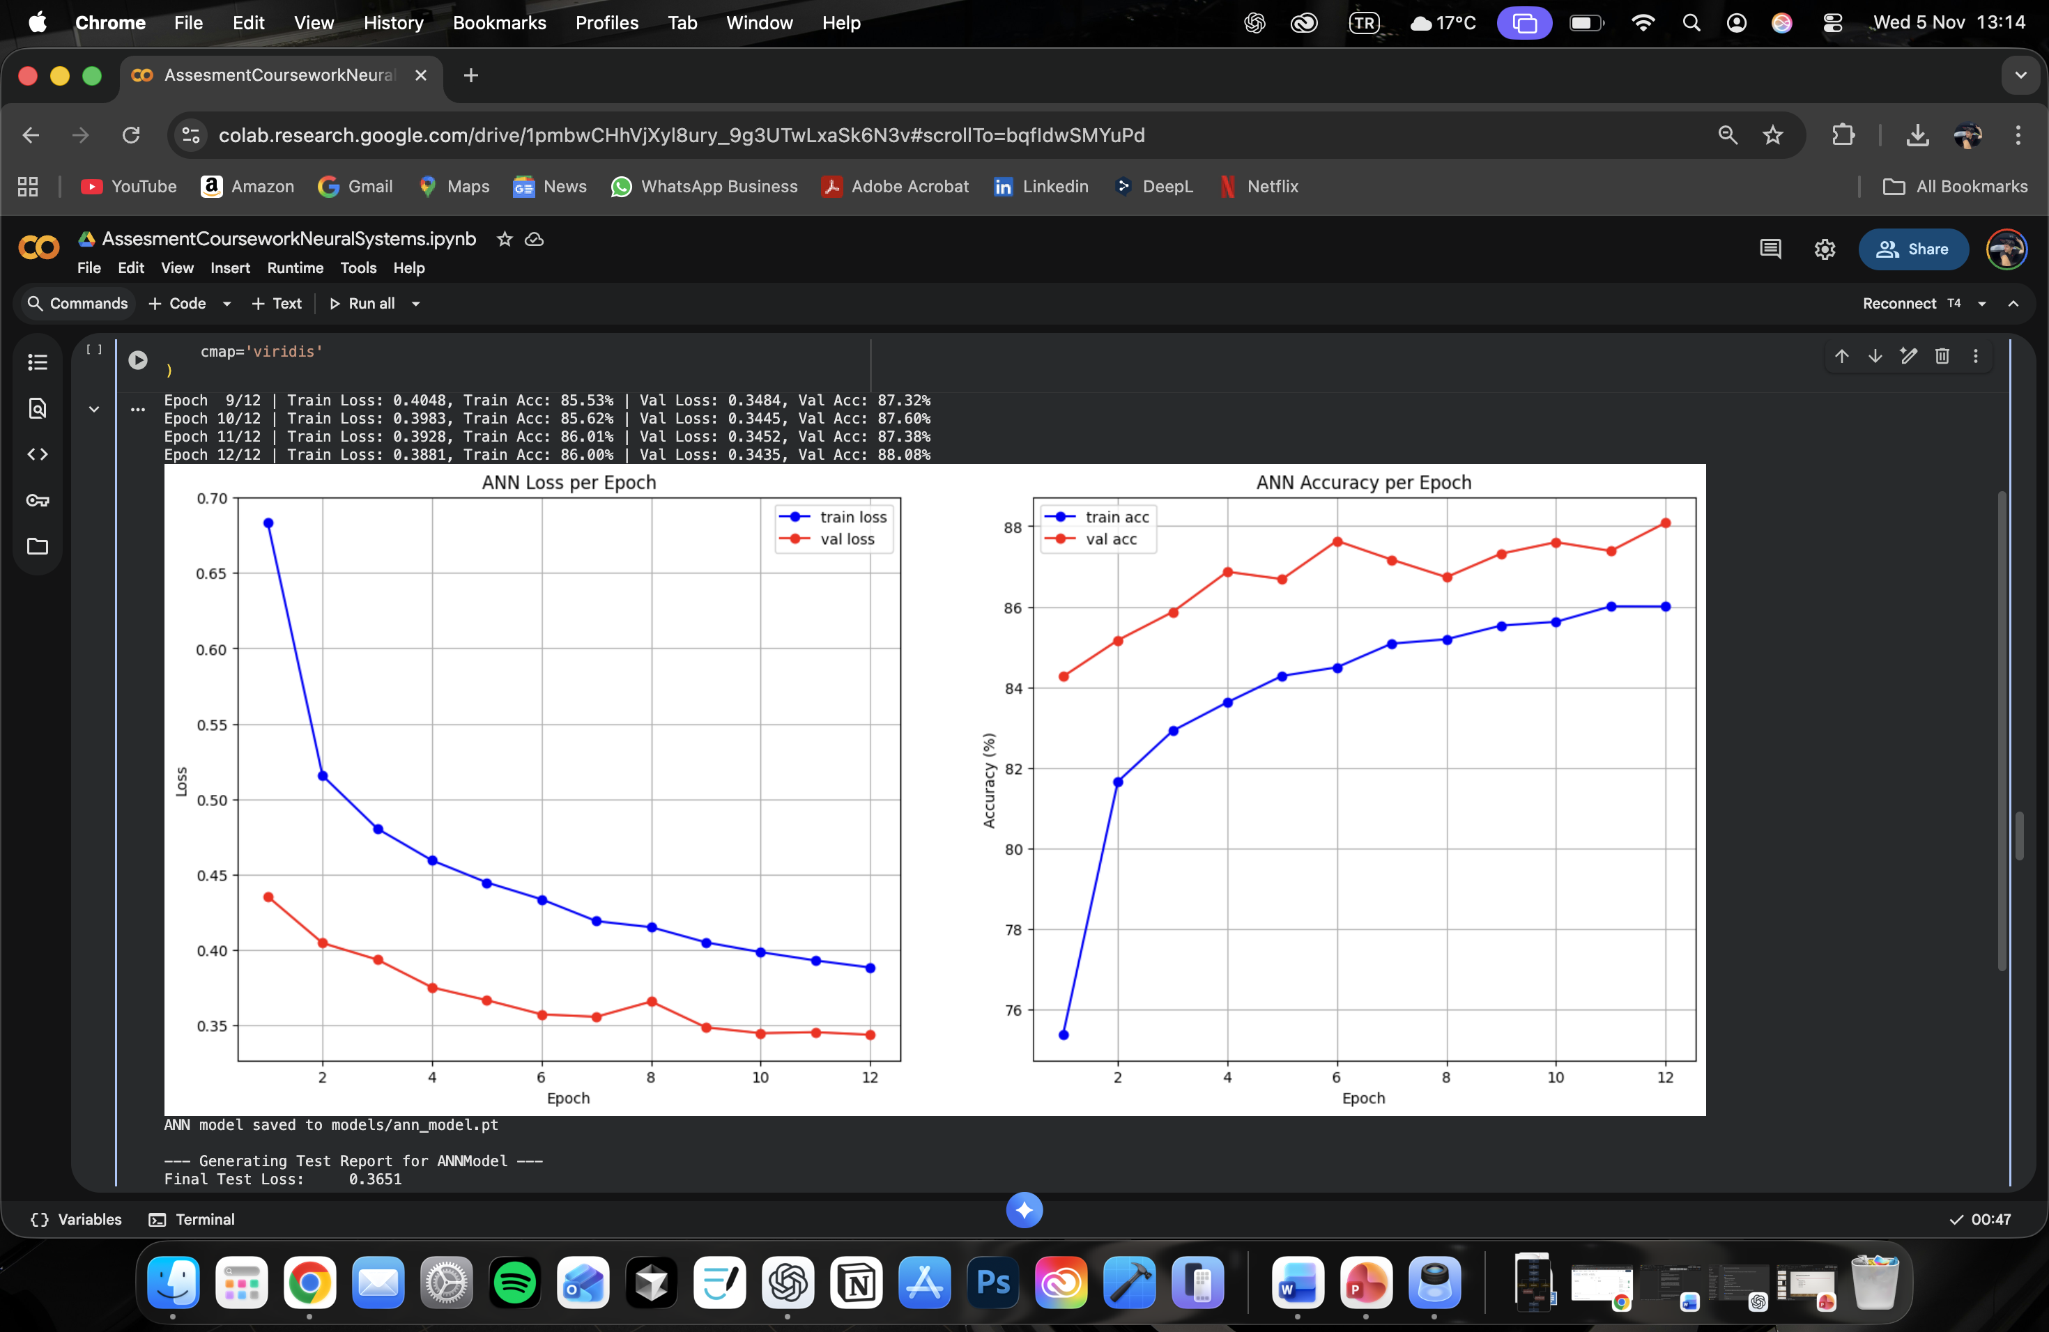
Results/fındıngs
ANN: Validation accuracy around epoch 7, demonstrating the signs of overfitting.

Slide 10
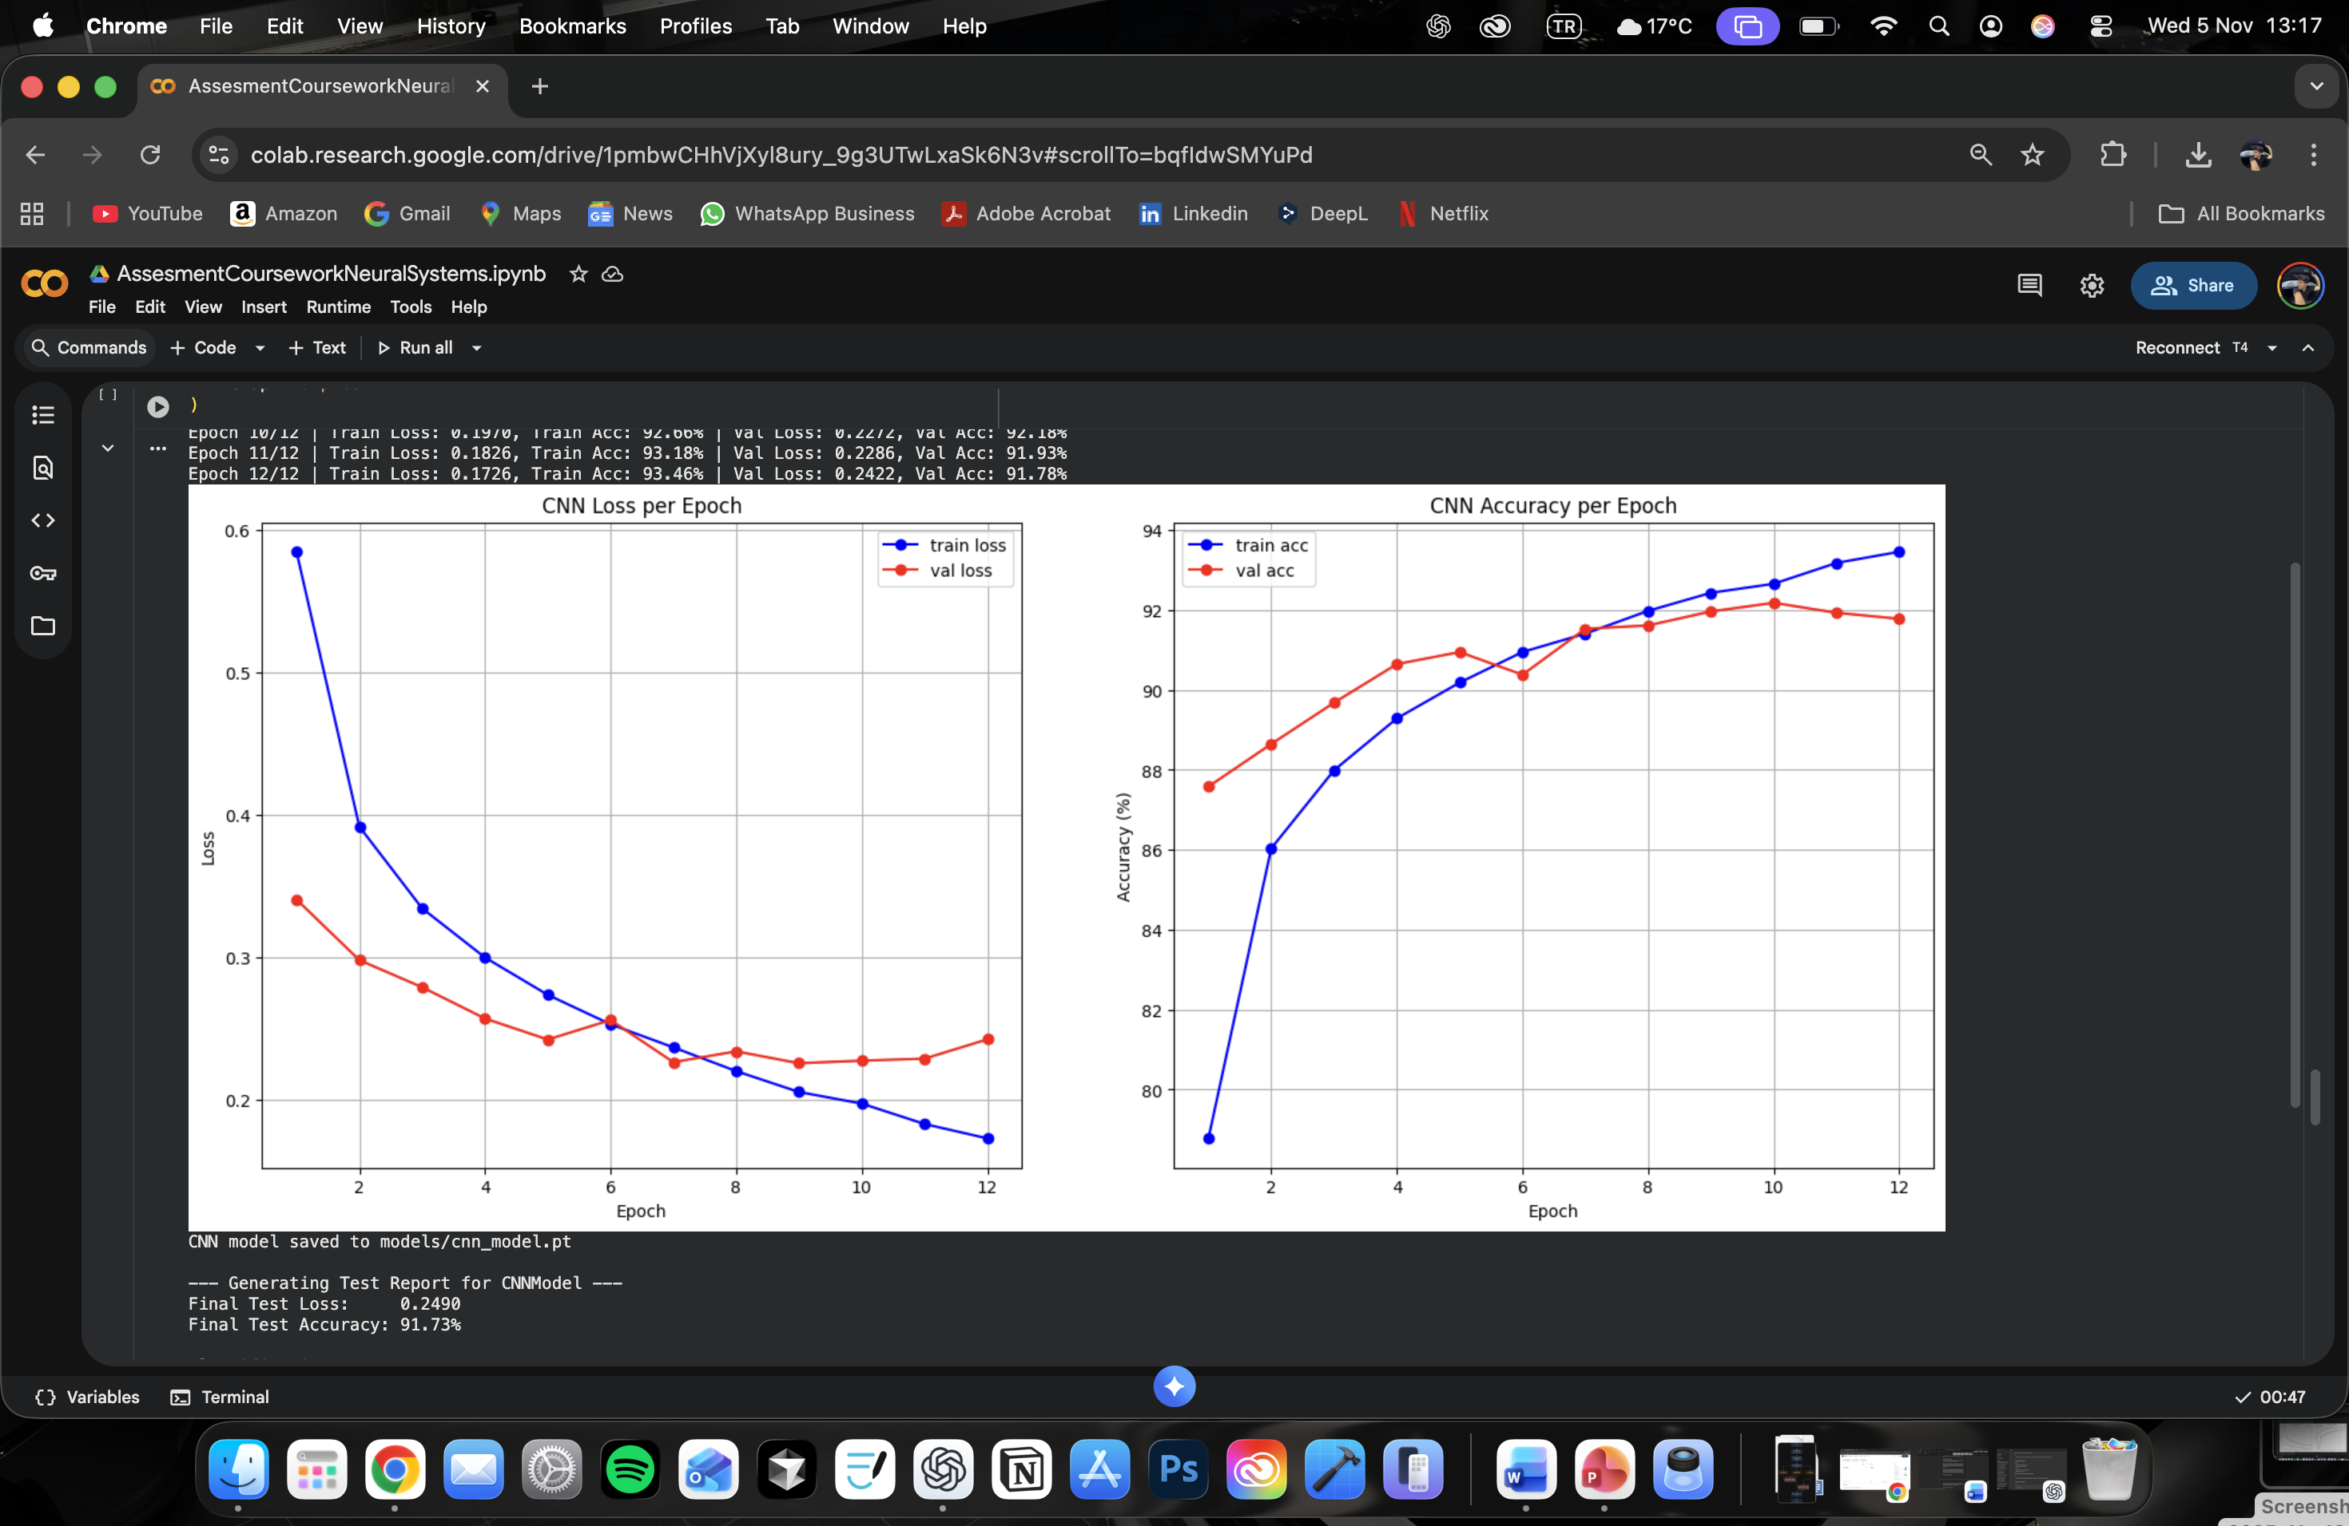
Results/fındıngs
CNN: Val acc tracks the train acc more closely.
This suggests a well-regularized model that generalizes better.

Slide 11
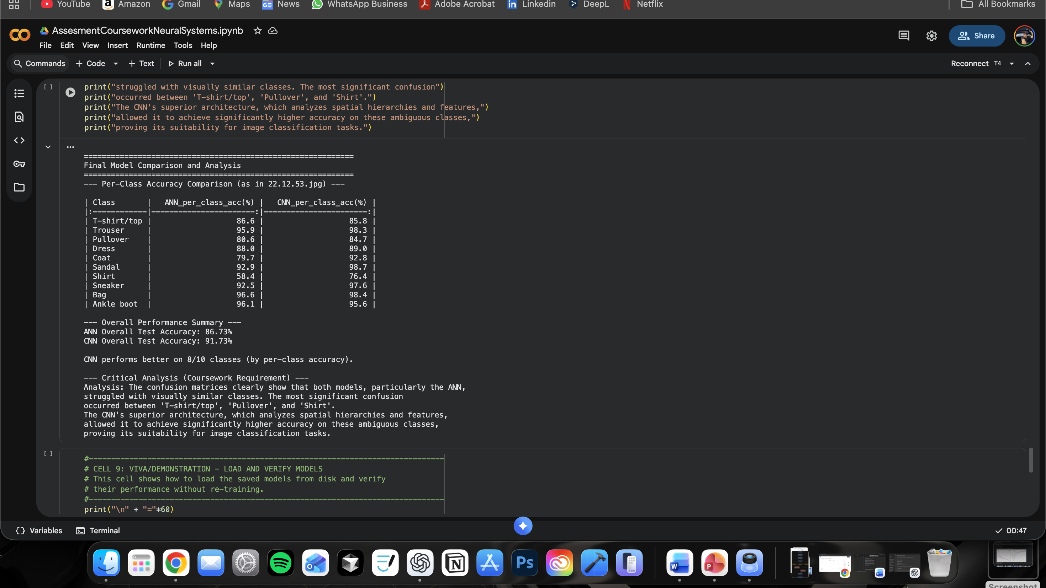
Dıscussıon

Slide 12
discussion
Key Findings:
CNN (%91.73) significantly outperforms ANN (%86.73).
CNN performs better on 8/10 classes (by per-class accuracy).
Challenge: Both models faced with similar items.
Analysis: The ANN (%58.4 on ‘Shirt’) fails because the lose of spatial data on Flatten layer. The CNN (%76.4 on ‘Shirt’) succeeded because Conv2d filter can learn to identify patterns.

Slide 13
Conclusion
Result: CNN performed better than ANN.
CNN (%91.73) > ANN (%86.73).
Key Innovation: Regularized both models successfully using dropout.
Key Achievements: Implemented and critically compared bot CNN and ANN models successfully, achieving all coursework specifications.
Key Learning: Learning the spatial hierarchies is clearly superior for CNN compared to the ANN’s vector-based approach for image tasks.

Slide 14
Future work
Future Improvements:
Data Augmentation: Implement RandomHorizontalFlip and RandomRotation to improve the ‘Shirt’ class accuracy and reduce overfitting.
Architecture: Experiment with a deeper CNN.

Slide 15

Q&A?

